Slide 1
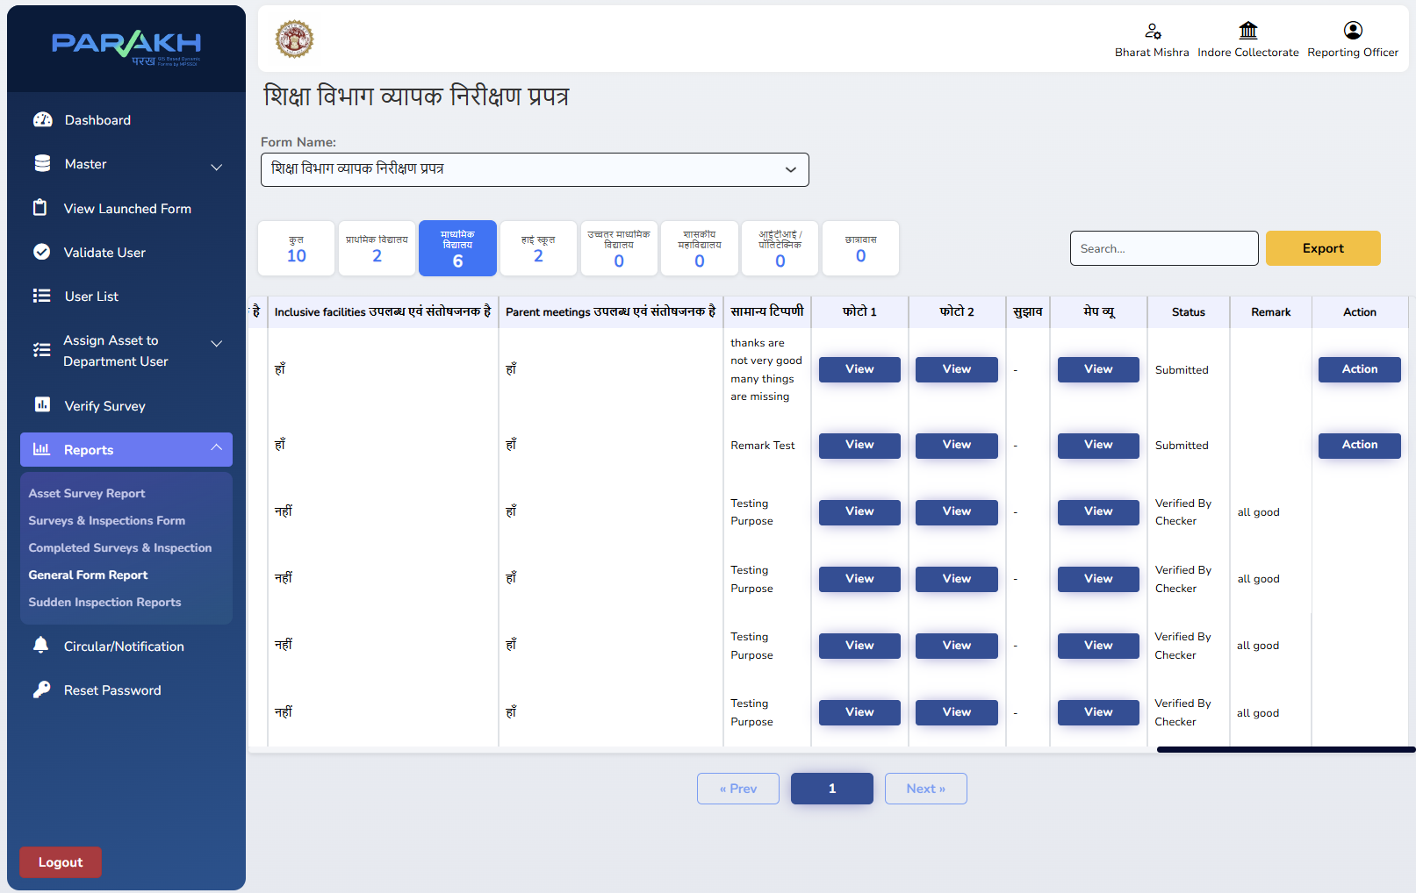
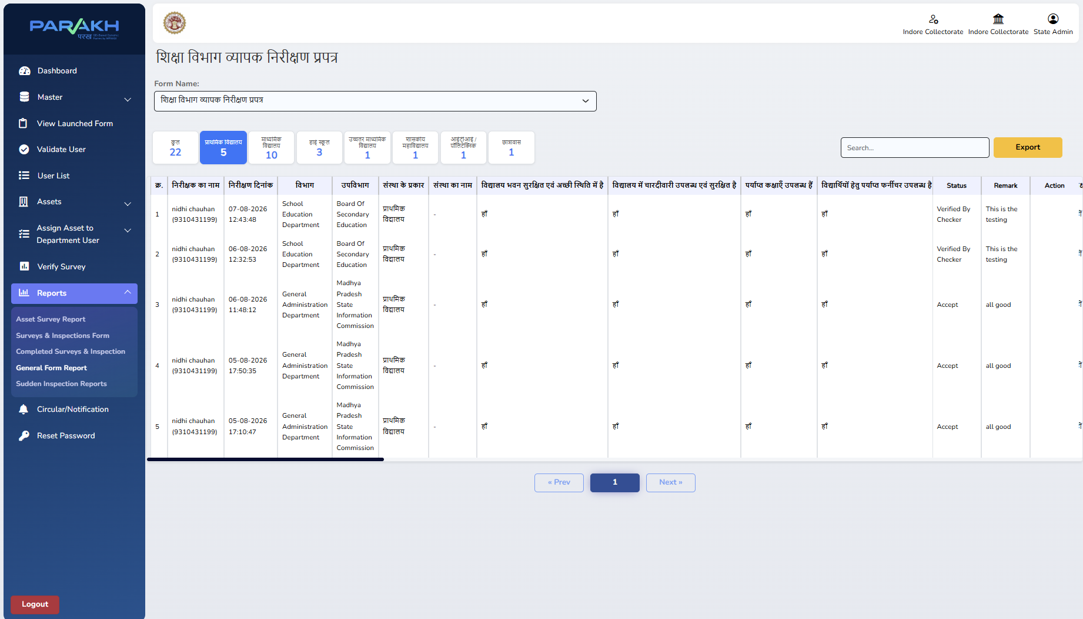
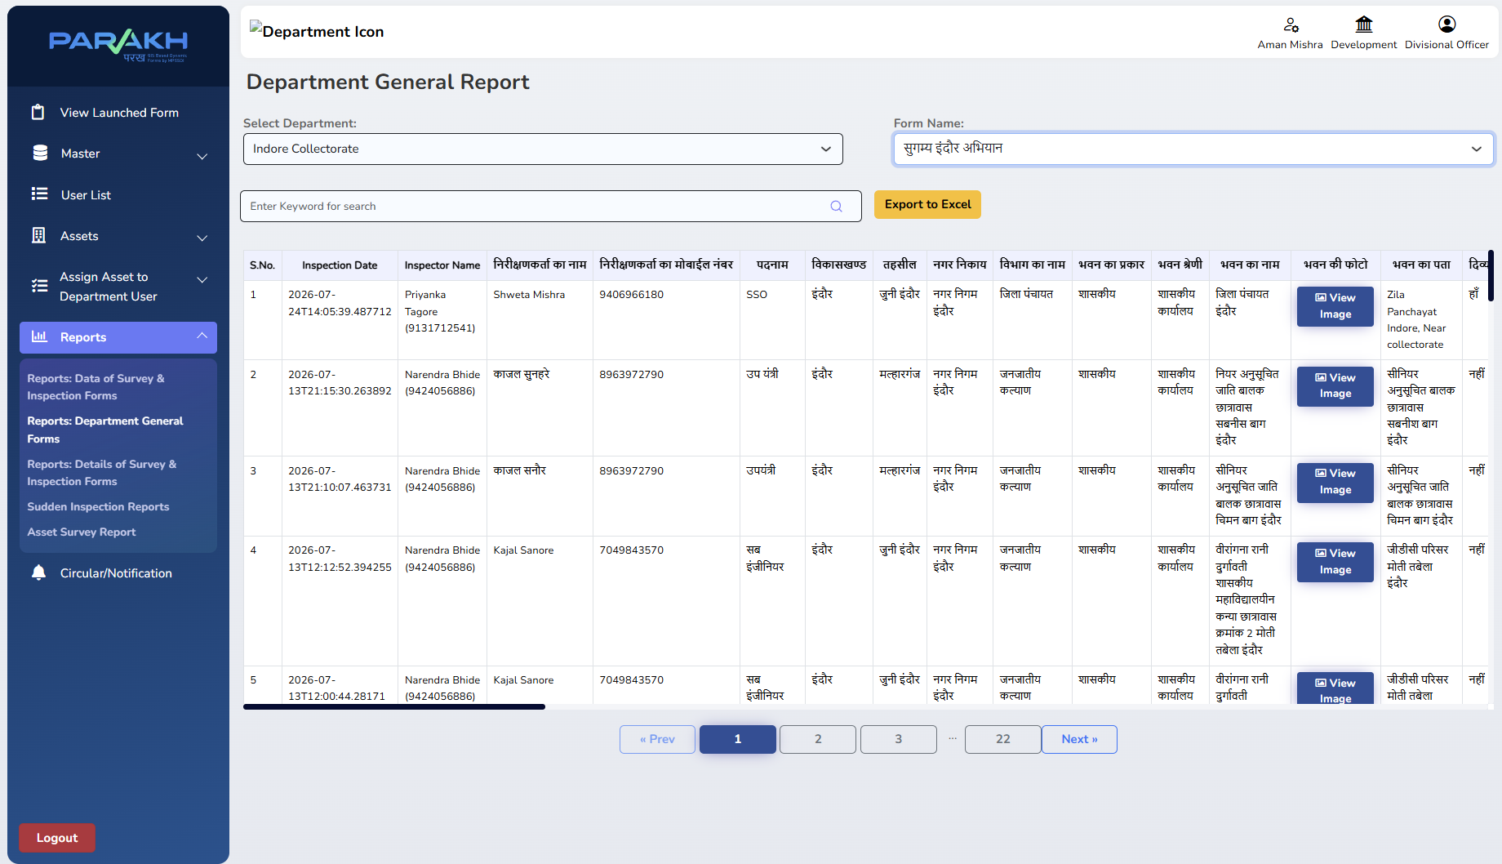
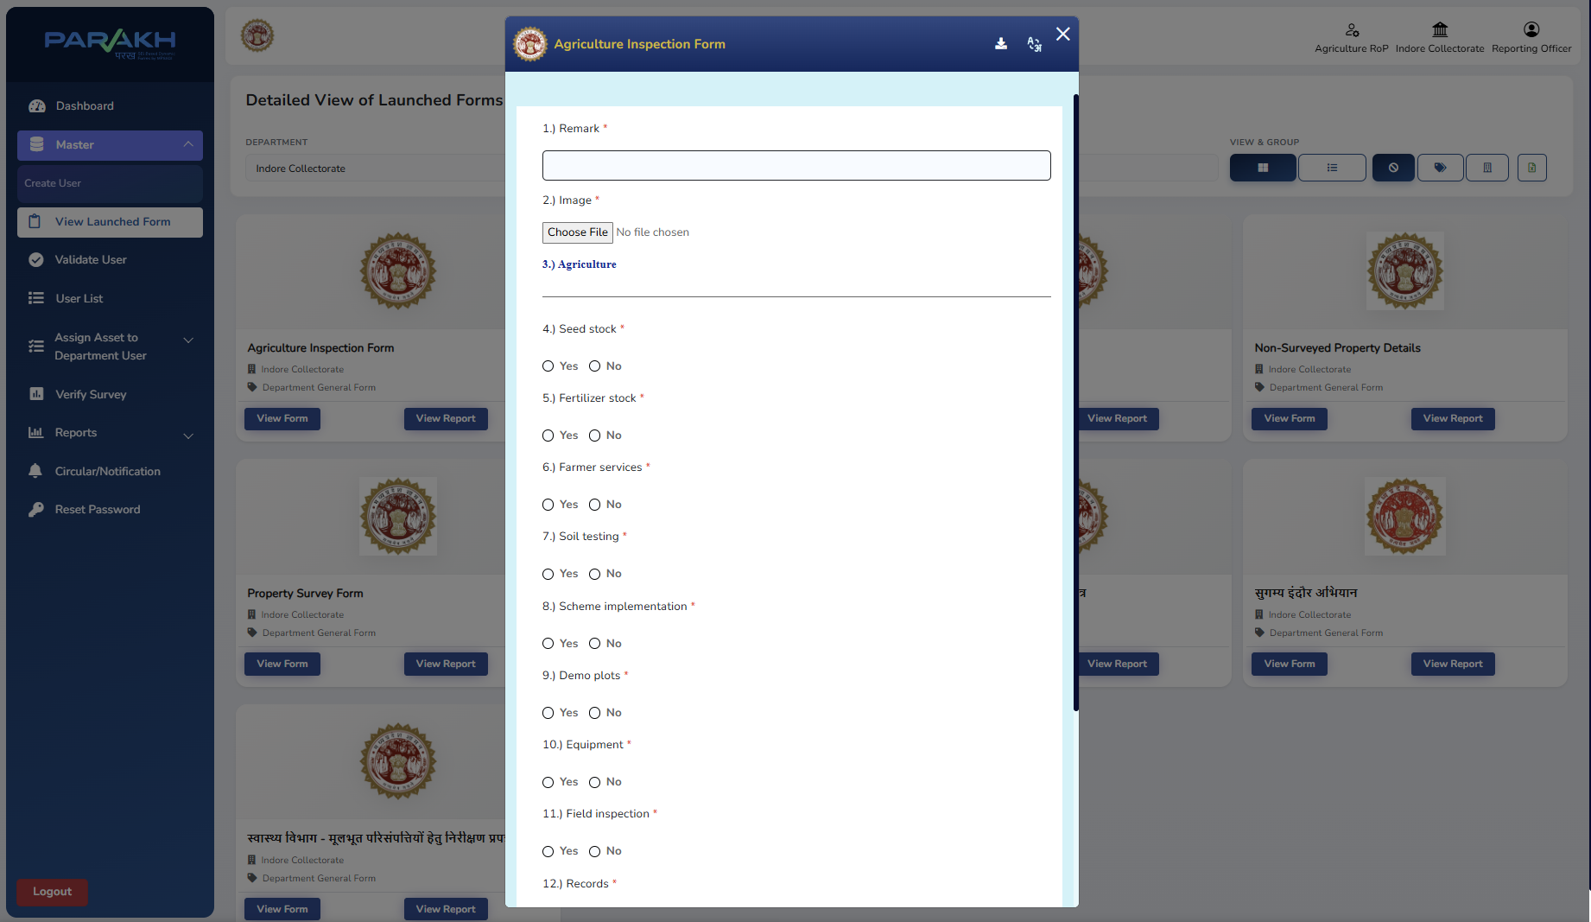
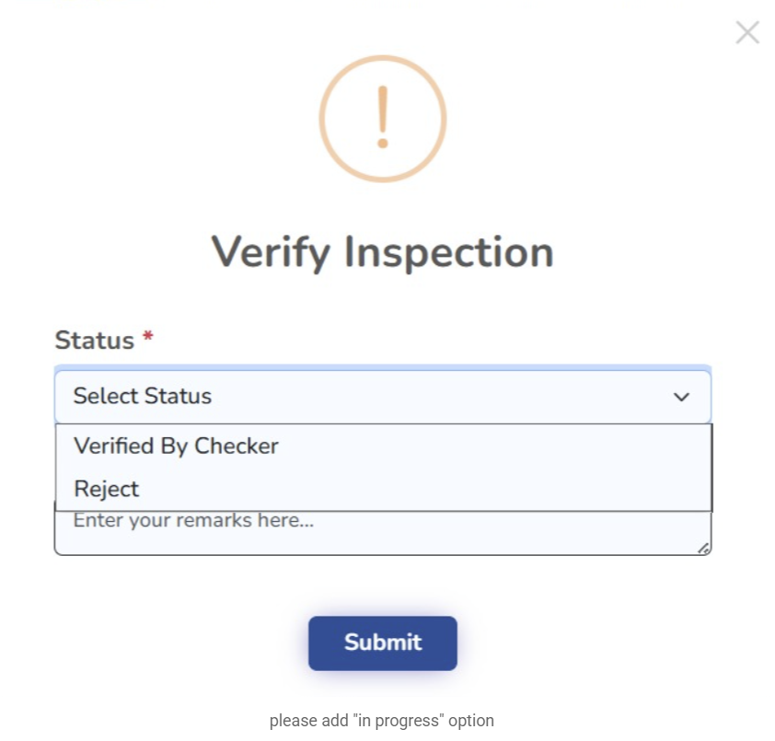
Division-Level Inspection Monitoring through District GIS Parakh by MPSeDC -
Use Cases- District GIS Parakh enables centralized inspection monitoring across all 8 districts of Indore Division through a unified divisional hierarchy. It provides district- and department-wise visibility, division-scoped user management, and consolidated inspection reports for effective review and administrative monitoring.
End-to-End Inspection Workflow: Field Capture → Review & Action → Collectorate Monitoring → Divisional Monitoring
1 FIELD INSPECTION
2 REVIEW & ACTION
3 COLLECTORATE MONITORING
4 DIVISIONAL MONITORING
Department-specific checklist
Remarks • Photos/Documents
Reporting Officer reviews
Verifies / Rejects with remarks
State Admin / Nodal Officer
Consolidated district-level oversight
8 districts + departments
Division-level report & analytics
INSPECTION FORM
REPORTING OFFICER
COLLECTORATE
DIVISIONAL MONITORING
Published department inspection form / checklist
Verify Inspection: status + remarks
State Admin view: Verified / Accept status
Division-level Department General Report
Form / Checklist
RO Action
District Monitoring
Division Monitoring
ONE PLATFORM • MULTIPLE DEPARTMENTS • 8 DISTRICTS • UNIFIED MONITORING

Slide 2
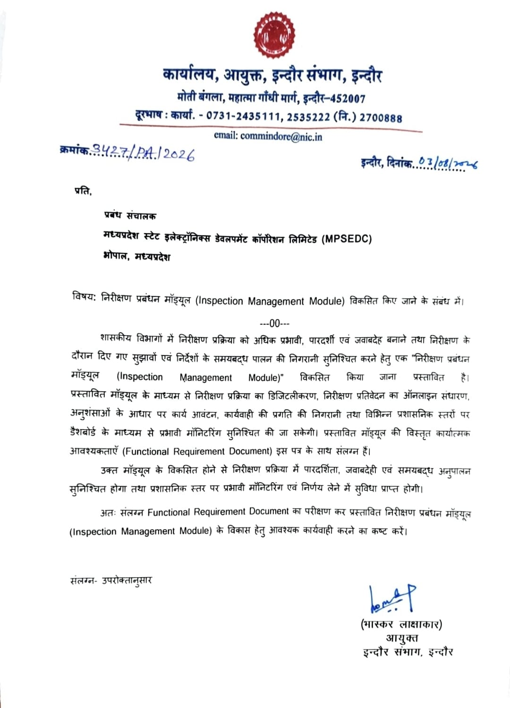
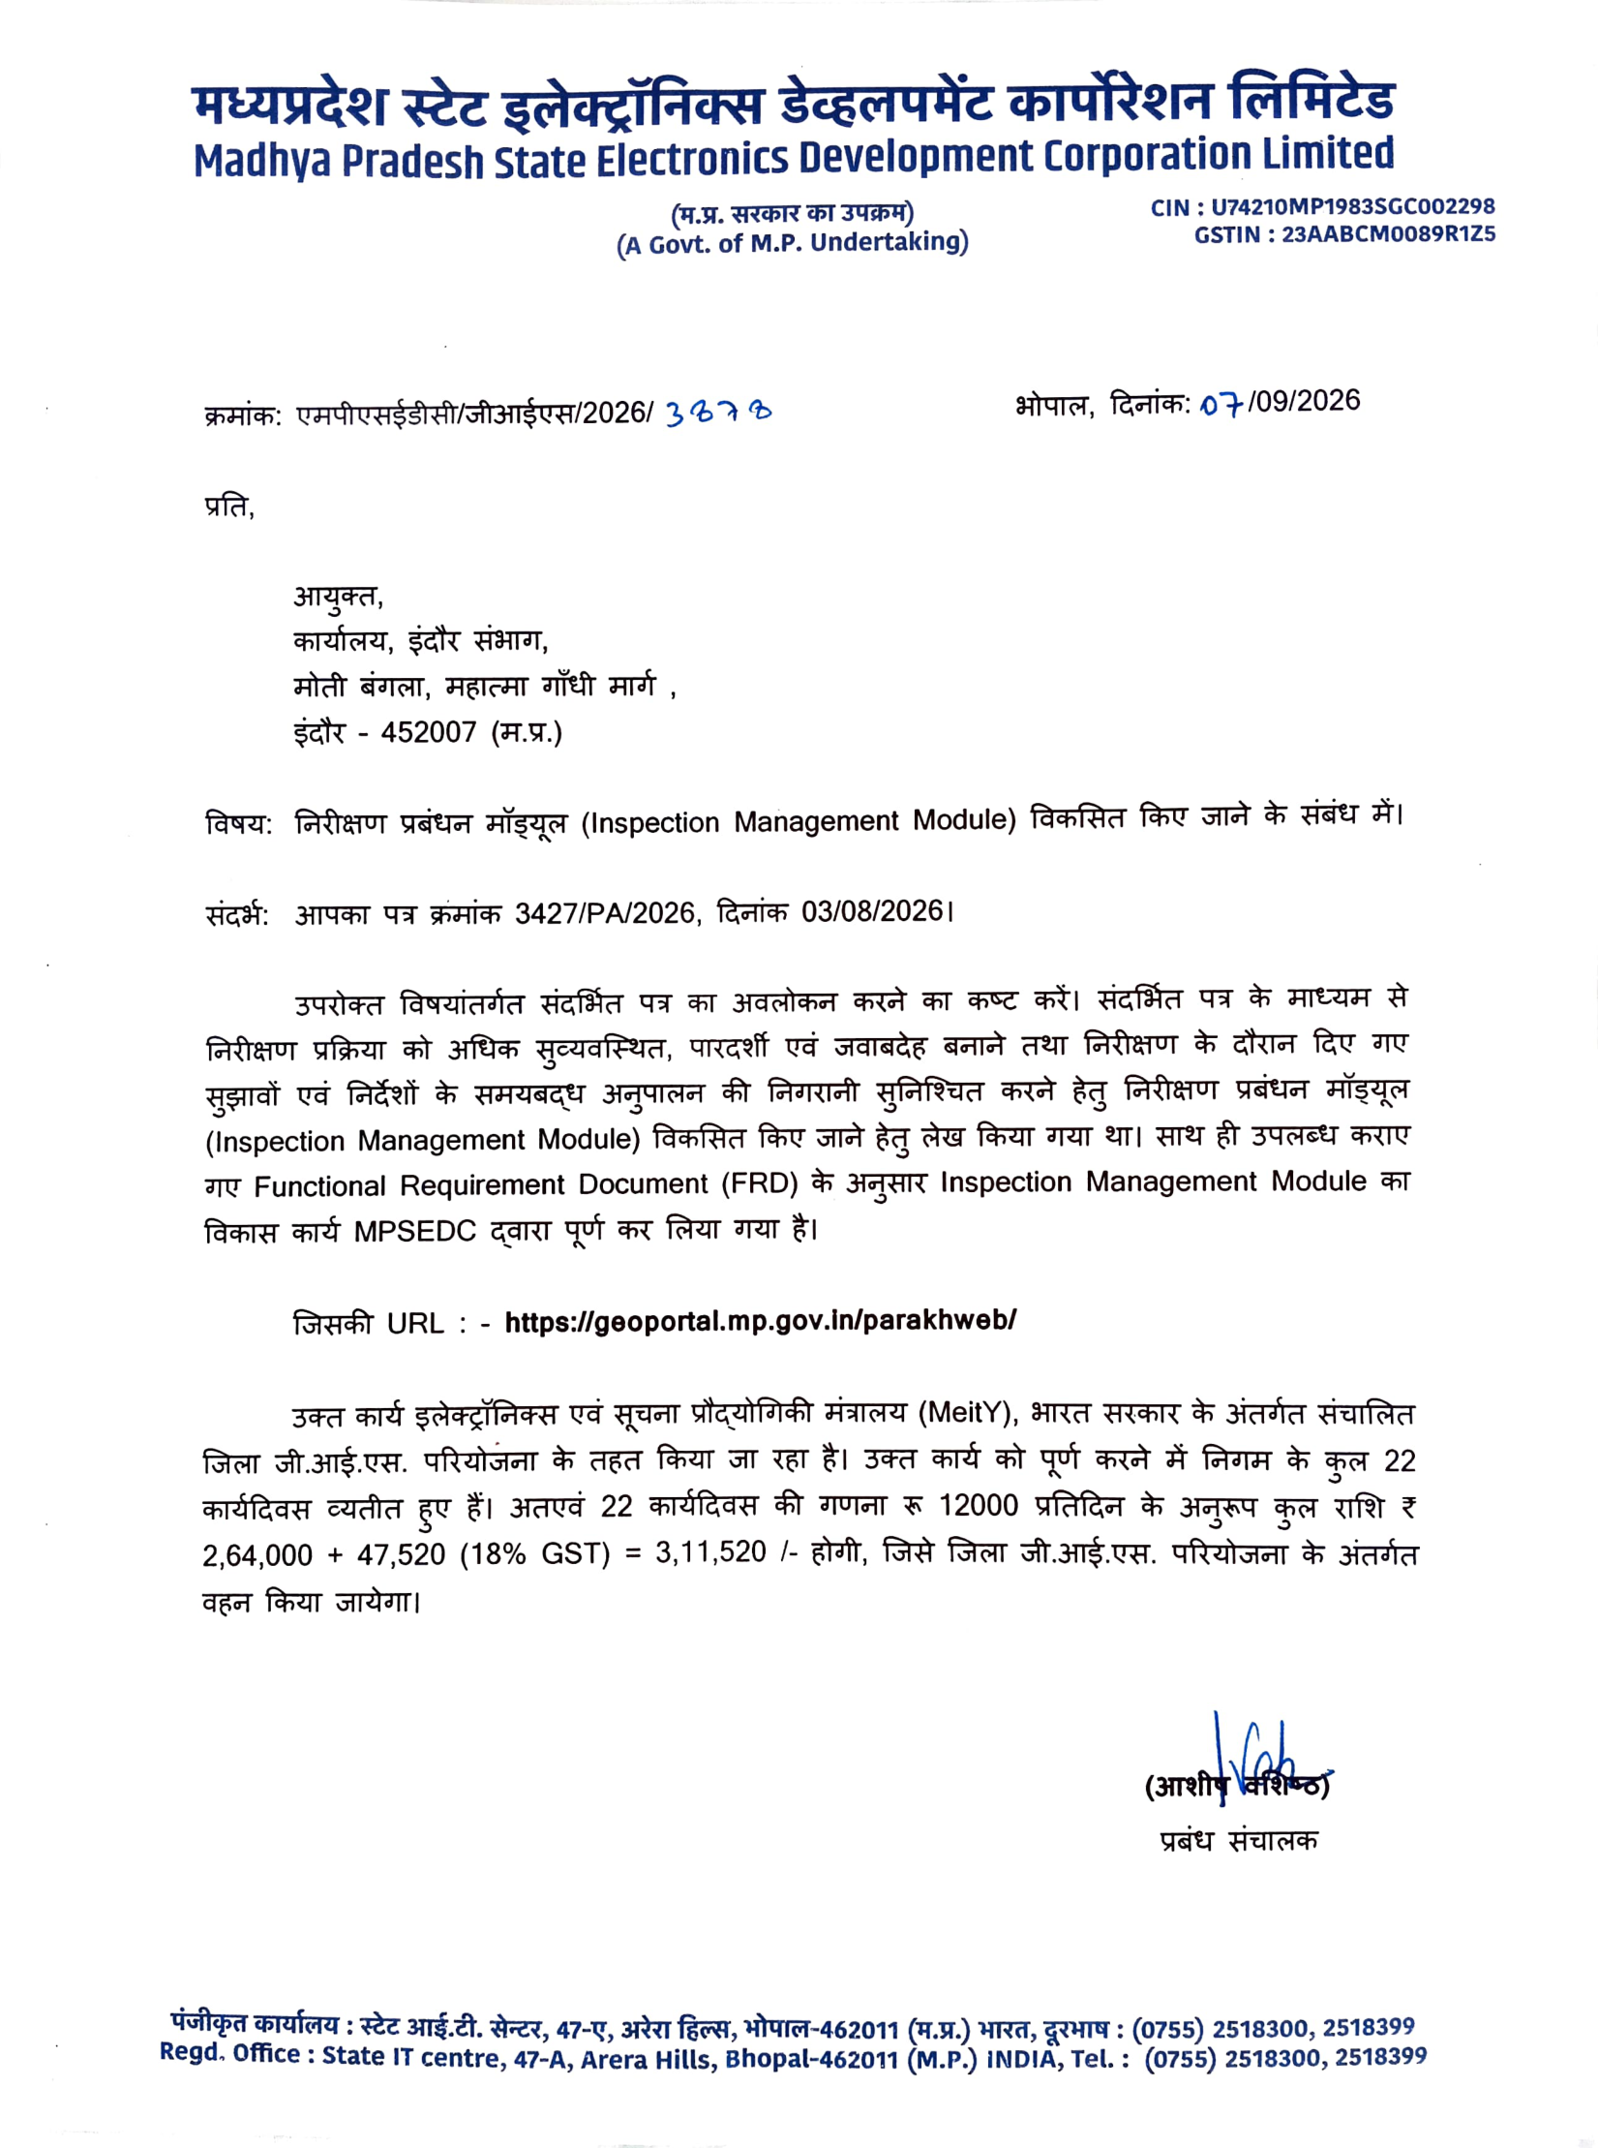
Official Letters | Inspection Management Module
Official communication supporting the Inspection Management Module
LETTER FROM COMMISSIONER, INDORE DIVISION
LETTER FROM MPSeDC
Official documents provided with the District GIS Parakh project materials

